Slide 1
How can we measure privacy risk?
Should a battery app collect your camera data?
If an app requests “unreasonable” permissions, is it riskier?
http://www.privacygrade.org/

Slide 2
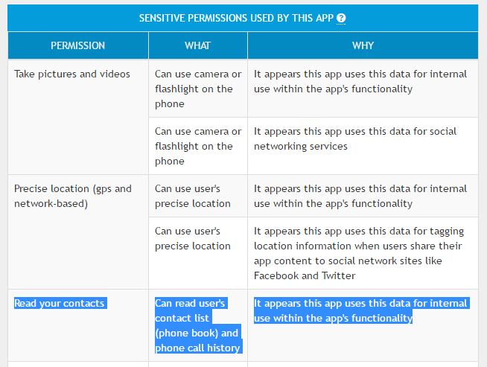
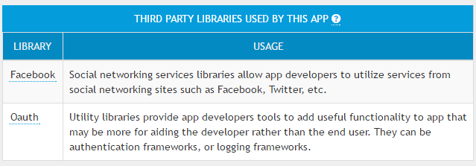
Grading apps

Slide 3
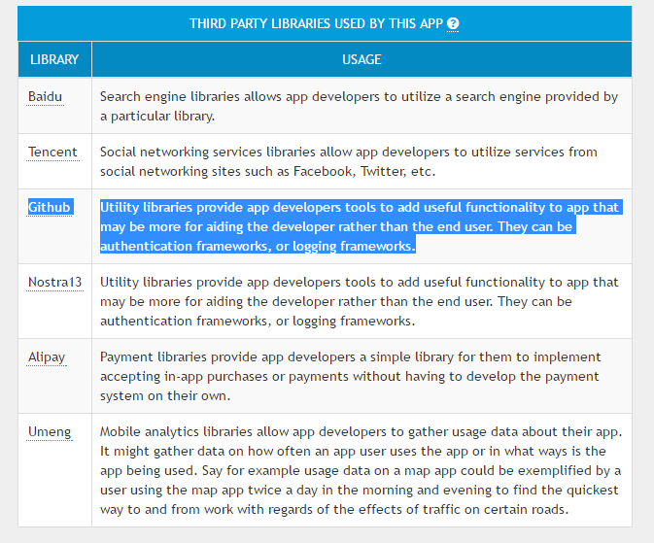
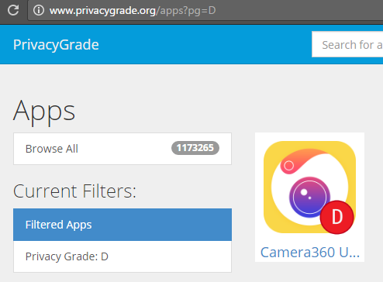
Comparing apps

Slide 4
What can we do?
Are there other ways of measuring privacy risk?
Differential privacy https://blog.cryptographyengineering.com/2016/06/15/what-is-differential-privacy/
Stochastic privacy http://research.microsoft.com/en-us/um/people/horvitz/stochastic_privacy.pdf

Slide 5
What does consent imply for app permissions?
What happens when you grant permissions to your app?
Do we understand how the data collected by the app is used, and by whom?
What are you really agreeing to?
Where IS all that info buried in the privacy policy?

Slide 6
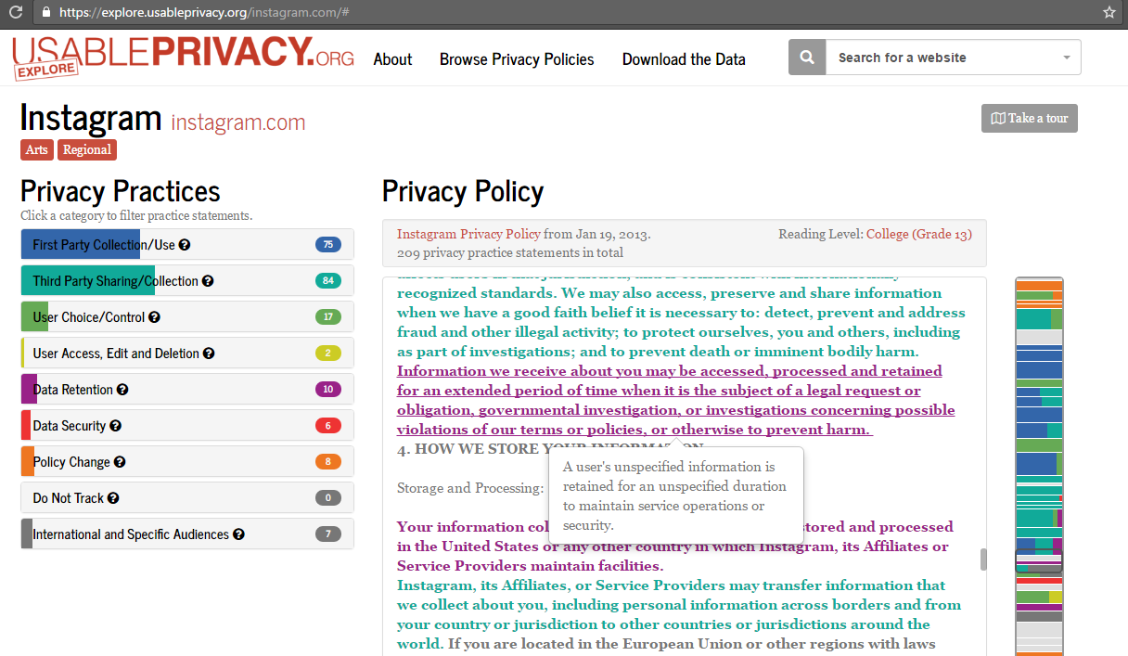
Understanding Instagram’s Privacy Policy
“Information we receive about you may be accessed, processed and retained for an extended period of time when it is the subject of a legal request or obligation, governmental investigation, or investigations concerning possible violations of our terms or policies, or otherwise to prevent harm.”
https://www.instagram.com/about/legal/privacy/
https://explore.usableprivacy.org/instagram.com/#

Slide 7
Comparing privacy policies
“Microsoft retains personal data for as long as necessary to provide the products and fulfill the transactions you have requested, or for other essential purposes such as complying with our legal obligations, resolving disputes, and enforcing our agreements. For example:
For Bing search queries, we de-identify stored queries by removing the entirety of the IP address after 6 months, and cookie IDs and other cross-session identifiers after 18 months.
In Outlook.com, when your Deleted Items folder is emptied, those emptied items remain in our system for up to 30 days before final deletion.
If you remove a credit card from your account, Microsoft will retain transaction records containing your credit card number for as long as reasonably necessary to complete any existing transactions, to comply with Microsoft's legal and reporting requirements, and for the detection and prevention of fraud.
Why automated analysis of privacy policies is hard
https://privacy.microsoft.com/en-us/privacystatement/

Slide 8
What can we do?
Help build a bot that makes it easier for you understand privacy policy jargon.
Download the annotated texts of privacy policies of a bunch of apps here - https://www.usableprivacy.org/data
Play with the data - ML + NLP
How can we answer simple questions like “How long will my data be stored?” in an automated manner? For starters, look at https://usableprivacy.org/publications
How can we help users make better choices? http://privacyassistant.org/

